Slide 1

The Future of Travel: Personalization
Nuja Zhang & Tracy Huang

Slide 2






Slide 3





New York

Slide 4



Our Solution
A personalized travel recommendation system
Destination
Hashtag
Search
Personalized
recommendations
#London #Switzerland
#NewYork
#Tokyo #Hawaii
…

Slide 5
Get Data
User Similarity Network
Bipartite Graph
Match & Recommend
Our Solution
A personalized travel recommendation system
Destination
Hashtag
Search
Personalized
recommendations
#London #Switzerland
#NewYork
#Tokyo #Hawaii
…

Slide 6
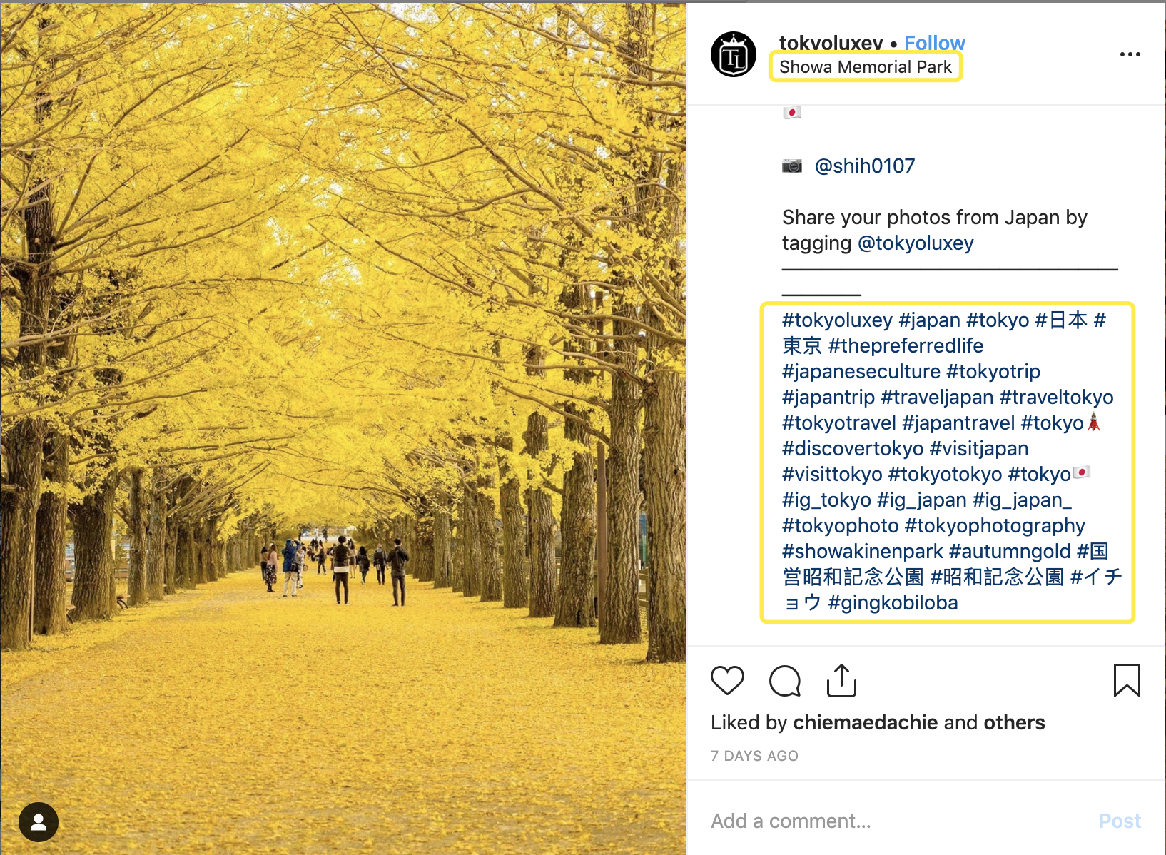


Get Data
User Similarity Network
Bipartite Graph
Match & Recommend
Scrape posts of a hashtag
Filtered by # of likes
User ID
Location name
Hashtags
#London #Tokyo
#Switzerland
#NewYork #Hawaii
…

Slide 7






Get Data
User Similarity Network
Bipartite Graph
Match & Recommend
Thrill Seekers
Theatre lovers
#thrilled
#exciting
#motorbike
#BMX
#freesolo
#andrewwebber
#broadwayshow
#neilsimon
Communities
Detected
Foodies
#yum #soulfood
#nomnom
#streetfood

Slide 8






Get Data
User Similarity Network
Bipartite Graph
Match & Recommend
“Best pizza!!!”
“Must-try street food”
“wine tour”
“Best seafood in town”
“Authentic ramen”
Users
Destinations

Slide 9
Get Data
User Similarity Network
Bipartite Graph
Match & Recommend
Ranked based on
degree centrality
of the destinations
Users
Destinations

Slide 10

Get Data
User Similarity Network
Bipartite Graph
Match & Recommend
Matched by similarity
New user/
Test set user
Foodies

Slide 11
Get Data
User Similarity Network
Bipartite Graph
Match & Recommend
Recommend
Popular places
For foodies
Compute Similarity A
(based on actual places visited)
Matched by similarity
New user/
Test set user
Foodies

Slide 12
Get Data
User Similarity Network
Bipartite Graph
Match & Recommend
Recommend
Popular places
For foodies
Compute Similarity A
(based on actual places visited)
Matched by similarity
New user/
Test set user
Compute Similarity B
(based on actual places visited)
Foodies
Recommend based on all user’s visits

Slide 13
Get Data
User Similarity Network
Bipartite Graph
Match & Recommend
Recommend
Popular places
For foodies
Compute Similarity A
(based on actual places visited)
If A > B, we have improved!
Matched by similarity
New user/
Test set user
Compute Similarity B
(based on actual places visited)
Foodies
Recommend based on all user’s visits

Slide 14
Get Data
User Similarity Network
Bipartite Graph
Match & Recommend
Thank you!

